Slide 1
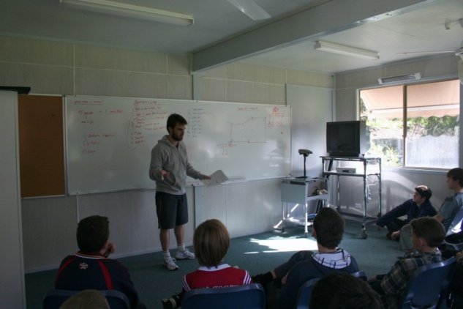
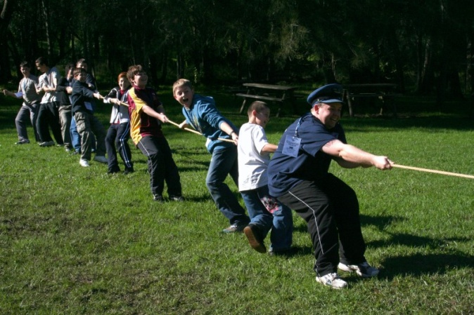
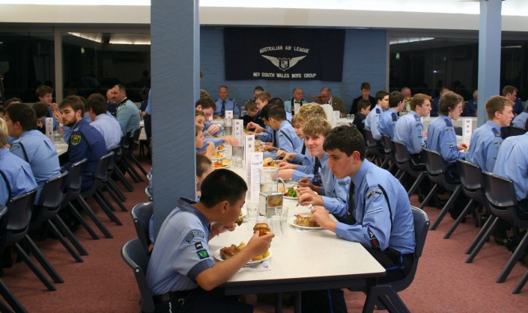
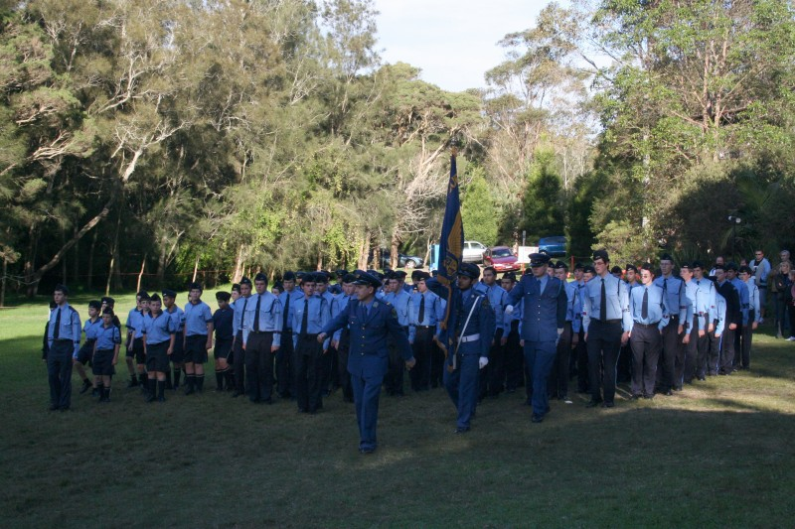
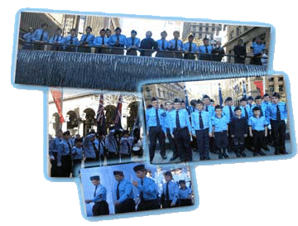
2012 NSW Boys Group
Officer’s, NCO’s and Band Training Camp
Publicity Twelve.
Your Community, Your Squadron

Slide 2
Talking About… Your Community
New Recruits
Squadrons Promotion
Squadrons Image
Impact
S

Slide 3
New Recruits
Getting New Recruits (Recruiting)
Welcoming Procedure
Make them feel apart of the Squadron
Training
Notes:
We will just have a discussion first on how your Squadron gain New Recruits and how effective it is. (Discuss points/ways to improve)
Its important to make your New Recruits feel apart of the Squadron. How many of you here had doubts about joining or were scared to join. Ask your O.C about giving new recruits temporary cadet numbers like R00012 , so when you call out the roll they have a number to say too. What other things might you do to make new recruits feel more involved and more apart of the Squadron?, What does you squadron do?
It is vital that New Recruits receive correct training and have plenty of resources. Use the Introduction course, and give New Recruits handouts of information specific to your Squadron.

Slide 4
Squadrons Promotion
Create Flyers/Brochures
Schools
Letterbox Drops
Information Booths / Recruiting Days
Notes:
To get new members you will have to promote your squadron to the public. If your Squadron Doesn’t have any then create Pamphlets or Brochures of your Squadron that detail the location of your Squadrons HQ, etc.
Promoting your Squadron at local schools is a must. How many of you have gone to a School in your uniform and promoted the air league? Its really easy to do. Go on the internet get the schools number and give it to your O.C/Adjutant and ask if he might be able to organise a day with the school.
Occasionally do letter box drops. Place Flyers in letter boxes around community.
Have regular recruiting days, invite other Squadrons, speak to potential members about joining

Slide 5
Squadrons Image
Have control of cadets when at events
Uniform / Presentation
Local Newspaper
Squadron Monthly/Quarterly Newsletter
Notes:
The way that people view the Air League will determine if they will allow their children to join. Make sure that you have control of cadets when you are in uniform in public and
Ensure that your uniform and that of the cadets are perfect, exact and the same.
It would be beneficial to get in contact with local newspapers and magazines to do an article about the Air League or an important achievement your Squadron has made.
If your Squadron doesn’t have one, make a Monthly or Quarterly Newsletter that details important achievements in the Squadron. This newsletter may be shown to potential members.

Slide 6
Impact
Community Impacts On Cadets
Cadets Impact On Community
Notes:
Keep up to date with community activities and possible impact on cadets. Like School Violence, Deaths, etc
Encourage cadets to do community service – provides good source of “advertising” for your squadron.

Slide 7
Talking About… Your Squadron
Your Squadron, The Way You Want It!
Helping Run The Squadron.
Developing Ideas & Proposals.
Reward System In A Squadron.
Don’t Forget Your Role.
S

Slide 8
Your Squadron, The Way You Want It!
Share Your Ideas & Opinions
Make change for the best
Don’t Step on Toes
How can you improve the Squadron?
Notes:
Your Squadron, The Way You Want It!
It doesn’t matter what rank or appointment you are, share your Ideas, share your opinions to other officers/NCOs. (Eg: Canteen/Break Time Allocation)
In doing this it will make change for the best. But you have to make sure that the change is the Best thing for the Squadron. Make sure you think about it because when things go wrong you may be blamed.
Also when you think about proposing a change, ensure that you don’t upset anyone's way of doing things if its working for them. If things are working people don’t like change!
Basically I want you to think about how you will improve your Squadron, make it better, what can you do that will make things run smother, giving cadets greater opportunities to excel, and making things easier.
Anyone have any Ideas that might improve your Squadron any way possible?

Slide 9
Helping Run The Squadron
Provide SUPPORT for officers & Sqn Sgt
Do Your Job
Offer Assistance
Do something more
Notes:
Helping Run The Squadron
This camp is all about this aspect of support and in a Squadron sense, as NCOs you guys should be supporting your Sqn NCOs & your Sqn Sgt. When you support someone, you backup and Second what they say, you should be standing buy your NCOs & your Sqn Sgt and not excluding or putting down their ideas or opinions. This will help let the Squadron achieve objectives set by Officers and NCOs, which will offer more opportunities and benefit cadets.
Its good to help others, but its more important to get your job done. Do your job or task perfect then help others. So if you’re a Flight Sergeant worry about teaching and helping the cadets in your flight.
You always have to remember that unless it is your responsibility to do something, you should only offer “Assistance”. When you come up with an idea that will provide assistance or help to an officer or to the Squadron, first approach your fellow NCOs and your Sqn Sgt in an NCO Meeting, then if approved by NCOs the Squadron Sergeant should take this Idea to the O.C/Adjutant, while you are approaching the Officer responsible for the aspect of the idea. (eg: To have more education classes available for cadet, you have to approach the Education Officer)
Depending on your commitment level, and how you see the Air League in relation to other hobbies. If your committed try and do a little bit more. Now… I have organised 2 Squadron Camps, Created a Database for keeping records in our Squadron, I have created many Systems and Programmes in my Squadron, so you are all capable of doing it. Do something more for your squadron and for your cadets.
This brings me to the next point.

Slide 10
Developing Ideas & Proposals
Support and Carry your Idea till the end
Get Approval
Examples of Ideas & Proposals
What might you develop for your Sqn?
Notes:
Its important that if and when you come up with an idea that you carry it out until its complete, and its important that you do most of the work to achieve the expected end result.
You must get approval form your fellow NCOs, Sqn Sgt, Officers and O.C before jumping into the deep end. Don’t start writing something up until you have gained approval. You may find that the time spent will be a waste of time, and you may not want to develop any ideas anymore.
So what kind of Ideas might you come up with. [show examples]
After looking at theses examples, What might you guys develop for your squadron.
We will focus on the Merit System for ensuring that cadets excel in all areas in a squadron.

Slide 11
Reward System In A Squadron.
What do cadets have to do to receive a Full Bronze Wing?
Brainstorm Ideas of a Reward System for your Squadron
Notes:
When developing something you have to make sure that you make it clear and simple for people to understand what message or goal you are attempting to get across. So… What do cadets have to do to receive a Full Bronze Wing?
Brainstorm Ideas of a Reward System for your Squadron.

Slide 12
Don’t Forget Your Role
Your Role in the Squadron is important
Have the courage.
Be there for your cadets, teach them well, and improve on what you have.
Notes:
Don’t forget that your role in the Squadron is important, don’t think of other appointments or roles as important than yours.
Be there for your Cadets, teach them well and improve on what you have.
Have the courage to share your ideas, if it is going to benefit your cadets then why hesitate.

Slide 13
Does Your Squadron:
Have a Schedule or Timetable
Have Resources for cadets (manual)
Fundraising Opportunities
Use your NCOs well?
Have something different in place?

Slide 14
Summary
Your Community
Your Squadron

